Slide 1
Wardriving from your pocket
Using Wireshark to Reverse Engineer Broadcom WiFi chipsets
Omri Ildis
Yuval Ofir
Ruby Feinstein
Notes:
Hello, we are Yuval, Omri and Ruby, and we are reversers coming from Israel.
We are going to talk about the process of reverse engineering Broadcom wifi chipsets, a pet project we were doing in the past few months in our spare time.
The project began when we were visiting ruby and we “forgot” his wireless network password.

Slide 2
Motivation!
Notes:
Probably most of you were in a scenario in which you “forgot” your wireless network password, or maybe you forgot your neighbor’s password, or maybe the coffe shop’s password.
But until today, whenever it happened to you – you had to take out a laptop, boot your favorite linux distro and run some cool linux utils like aircrack, wash, etc…
But we don’t carry a laptop everyday all the time… and taking out your laptop whenever you need to capture some packets looks pretty lame, so we thought of another solution – do it with your phone.
It is much more cooler and practical than the old laptop method.
After all - my super-smart android phone is running linux, it is equppied with an impressive CPU, and it supports wifi. So it should be enough. Isn’t it?
We started this project with a dim vision – to successfully run aircrack on our android, but we were not sure what exactly we need to do

Slide 3
d:\> adb shell
iwconfig
#
iwconfig
eth0 IEEE 802.11-DS ESSID:"GeverNet" Nickname:""
Mode:Managed Frequency:2.437 GHz Access Point: 00:25:9C:34:D4:F6
Bit Rate=11 Mb/s Tx-Power:32 dBm
Retry min limit:7 RTS thr:off Fragment thr:off
Encryption key:off
Power Managementmode:All packets received
Link Quality=3/5 Signal level=-68 dBm Noise level=-84 dBm
Rx invalid nwid:0 Rx invalid crypt:0 Rx invalid frag:0
Tx excessive retries:4 Invalid misc:0 Missed beacon:0
#
tcpdump -i eth0 -w /data/data/bcmon/test.cap
tcpdump -i eth0 -w /data/data/bcmon/test.cap
tcpdump: listening on eth0, link-type EN10MB (Ethernet), capture size 96 bytes
Notes:
So we took ruby’s phone.
At first, we’ve found a teardown of it and learned that it is equipped with a wifi chipset made by Broadcom, called BCM4329 (four-three-two-nine)
Then, we started exploring Ruby’s phone, and treated it as a simple linux device.
Whenever you explore a linux device – the first thing you want to do is get a shell access to the device, so we used android way of getting shell access (CLICK), and ran “iwconfig” – a simple linux utility used to configure wireless interfaces, and “tcpudmp” – in order to capture some packets.
But… We quickly noticed some strange things:
- our network device is responding to iwconfig with meaningful information. But… why is the device called eth(zero) instead of wlan(zero)?
- tcpdump identifies it as an Ethrnet device and not as a wifi device
It seems that this network interface isn’t behaving like a “normal” wifi interfaces, but more like an Ethernet interface. Whats going on?

Slide 4
Notes:
To understand how wifi interfaces should behave, lets talk a bit about how wifi works in general:
Wifi has 3 types of frames:
Data frames - like it sounds, contains….. data. It has a very simple form – a wifi header (containing MAC addresses and some crypto stuff), and then…. IP/TCP,you name it…
Management frames – contains data about the available wireless networks – Examples – beacons (periodical “advertisement” for a wireless network), Handshakes of client with wireless networks, etc…
Control frames – Used mainly for flow control, to reduce congestion on wireless networks.

Slide 5
Notes:
But on the real world, when we capture packets on the device we don’t see any MGMT and CONTROL frames. (CLICK)
We see only DATA frames, and even that frames doesn’t look like wifi at all… it looks like someone tool the data portion out of the DATA frame and sent it as an Ethernet frame.
And with our vision in mind, tools like aircrack cant work with this packet manipulation – because those cool pwnage tools uses information from the wifi header, from frames which are sent to other clients, from management frames and so on…

Slide 6
AIR
802.11
LINUX
ETHERNET
Notes:
So… somehow, in the air – the frames were surely sent as WiFi frames, but when we get the frames in user-mode, we get them as Ethernet frames. where is this translation performed?
We have 2 suspects:
In the WiFi Chip
In the linux kernel
Since the android kernel (well, Linux…) is open-source, it is easier to start with.

Slide 7
/* Return true if there may be more frames to read */ static uint dhdsdio_readframes(dhd_bus_t *bus, uint maxframes, bool *finished){
.
.
.
#ifdef DHD_DEBUG if (DHD_BYTES_ON() && DHD_DATA_ON()) { printk(KERN_DEBUG "Rx Data:\n"); print_hex_dump_bytes("", DUMP_PREFIX_OFFSET, rxbuf, len);
}
#endif
.
.
.
}
Notes:
So we began reading the kernel module’s code and we searched for a function that receives the frame off the chipset.
We wanted to see if the kernel is receiving Wifi frames or Ethernet frames.
We quickly found the function you see on the screen which reads one frame off the chipset.
Inside the IFDEF in the middle of the screen, there’s a debug print which prints the incoming frame EXACTLY like it received it.
So we turned the debug prints on and recompiled the driver.

Slide 8
.
.
.
#ifdef DHD_DEBUG
#define DHD_ERROR(args) do {if (dhd_msg_level & DHD_ERROR_VAL) printf args;} while (0)
#define DHD_TRACE(args) do {if (dhd_msg_level & DHD_TRACE_VAL) printf args;} while (0)
#define DHD_INFO(args) do {if (dhd_msg_level & DHD_INFO_VAL) printf args;} while (0)
#define DHD_DATA(args) do {if (dhd_msg_level & DHD_DATA_VAL) printf args;} while (0)
#define DHD_CTL(args) do {if (dhd_msg_level & DHD_CTL_VAL) printf args;} while (0)
#define DHD_TIMER(args) do {if (dhd_msg_level & DHD_TIMER_VAL) printf args;} while (0)
#define DHD_HDRS(args) do {if (dhd_msg_level & DHD_HDRS_VAL) printf args;} while (0)
#define DHD_BYTES(args) do {if (dhd_msg_level & DHD_BYTES_VAL) printf args;} while (0)
#define DHD_INTR(args) do {if (dhd_msg_level & DHD_INTR_VAL) printf args;} while (0)
#define DHD_GLOM(args) do {if (dhd_msg_level & DHD_GLOM_VAL) printf args;} while (0)
#define DHD_EVENT(args) do {if (dhd_msg_level & DHD_EVENT_VAL) printf args;} while (0)
#define DHD_BTA(args) do {if (dhd_msg_level & DHD_BTA_VAL) printf args;} while (0)
#define DHD_ISCAN(args) do {if (dhd_msg_level & DHD_ISCAN_VAL) printf args;} while (0)
.
.
.
Notes:
Actually – when we turned it on, it started printing a LOT of information. too much information…
if we have’nt cleared the dmesg log every few seconds – the phone would crash.

Slide 9
dmesg
#
.
.
.
dhdsdio_readframes: Enter
RxHdr:
0000: 74 00 8b ff 1a 02 00 0e 00 12 00 00
Rx Data:
0000: 74 00 8b ff 1a 02 00 0e 00 12 00 00 00 00 10 00
0016: 00 ba 38 e7 d8 64 22 02 00 25 9c 34 d4 f4 08 00
0032: 45 00 00 54 00 00 00 00 2b 01 0f b7 08 08 08 08
0048: 0a 64 65 7f 00 00 4b cb 27 08 00 01 6f 36 eb 50
0064: 45 a1 02 00 08 09 0a 0b 0c 0d 0e 0f 10 11 12 13
0080: 14 15 16 17 18 19 1a 1b 1c 1d 1e 1f 20 21 22 23
0096: 24 25 26 27 28 29 2a 2b 2c 2d 2e 2f 30 31 32 33
0112: 34 35 36 37
.
.
.
Notes:
So we cleared the dmesg log every few seconds (CLICK)
Between the huge amount of data we received, we’ve found the incoming frame EXACTLY like the chip sent it to the linux.
This is an example of an incoming packet

Slide 10
dmesg
#
.
.
.
dhdsdio_readframes: Enter
RxHdr:
0000: 74 00 8b ff 1a 02 00 0e 00 12 00 00
Rx Data:
0000: 74 00 8b ff 1a 02 00 0e 00 12 00 00 00 00 10 00
0016: 00 ba 38 e7 d8 64 22 02 00 25 9c 34 d4 f4 08 00
0032: 45 00 00 54 00 00 00 00 2b 01 0f b7 08 08 08 08
0048: 0a 64 65 7f 00 00 4b cb 27 08 00 01 6f 36 eb 50
0064: 45 a1 02 00 08 09 0a 0b 0c 0d 0e 0f 10 11 12 13
0080: 14 15 16 17 18 19 1a 1b 1c 1d 1e 1f 20 21 22 23
0096: 24 25 26 27 28 29 2a 2b 2c 2d 2e 2f 30 31 32 33
0112: 34 35 36 37
.
.
.
ETHERNET HEADER
Notes:
This is the Ethernet header

Slide 11
dmesg
#
.
.
.
dhdsdio_readframes: Enter
RxHdr:
0000: 74 00 8b ff 1a 02 00 0e 00 12 00 00
Rx Data:
0000: 74 00 8b ff 1a 02 00 0e 00 12 00 00 00 00 10 00
0016: 00 ba 38 e7 d8 64 22 02 00 25 9c 34 d4 f4 08 00
0032: 45 00 00 54 00 00 00 00 2b 01 0f b7 08 08 08 08
0048: 0a 64 65 7f 00 00 4b cb 27 08 00 01 6f 36 eb 50
0064: 45 a1 02 00 08 09 0a 0b 0c 0d 0e 0f 10 11 12 13
0080: 14 15 16 17 18 19 1a 1b 1c 1d 1e 1f 20 21 22 23
0096: 24 25 26 27 28 29 2a 2b 2c 2d 2e 2f 30 31 32 33
0112: 34 35 36 37
.
.
.
BROADCOM HEADER
Notes:
And this is a header added by the Broadcom chipset…
It seems that the chip already sent it as Ethernet packet…
(CLICK)
So… the linux is not the componenet converting wifi to Ethernet…

Slide 12
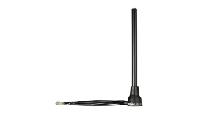
WiFi frames
SoftMac
CPU
MAC
FullMac
Ethernet frames
CPU
MAC
Notes:
We began researching - why is the chip designed this way? Why is it designed to send Ethernet packets?
There are 2 approaches for implementing wifi chipsets.
The simple approach (mostly used in laptops, PC’s, etc…) is called Soft MAC. On Soft MAC devices – the chipset is just a simple modem., it get packets from air, and sends them to the PC without any manipulation.
The PC is in charge of associating to networks, understanding beacons, cipher, etc…
When using soft mac chipsets – there is no problem running tools like aircrack, etc, because the linux box already sees the packets as wifi packets.
The other approach is “full MAC”. On those chips – the linux doesn’t have to understand WiFi at all – the chip is doing the hard work.
The linux asks the chip high level things like “Please scan for available networks“, or “please connect to network X/Y”, but the linux doesn’t need to do anything wifi related besides this.
On those chips the linux usually sees the device as Ethernet device as it’s very simple to implement, and the chip is “translating” each Ethernet packet into Wifi packet and vice versa.
Well, this is clearly the case with our chipset, its full mac!

Slide 13
AIR
802.11
LINUX
ETHERNET
Notes:
So we have to look at the chip (CLICK)
But… aircrack seems to run even on some fullmac chips… how it does that? Sin two words – monitor mode

Slide 14
Monitor mode From Wikipedia, the free encyclopedia
Monitor mode, or RFMON (Radio Frequency MONitor) mode, allows a computer with a wireless network interface controller (WNIC) to monitor all traffic received from the wireless network. Unlike promiscuous mode, which is also used for packet sniffing, monitor mode allows packets to be captured without having to associate with an access point or ad-hoc network first.
Notes:
Monitor mode is a special mode of wifi chip & driver which guarantees that as long as your’e in this mode – the wifi stack is not doing any monkey business - no wifi to Ethernet conversion, No association with Access Point, just a simple modem.
In Soft MAC chips, monitor mode is trivially supported – it only means that the OS shouldn’t respond to any WIFI stuff and just send everything to usermode…
In Full MAC chips, sometimes monitor mode is also implemented….
And this is what we want to do. We want monitor mode on our chip!
Now we have a goal
Promisc - Worth mentioning?

Slide 15
tasks
Easy solutions
Driver modification
Contact Broadcom
Implement monitor mode ourselves
Extract Firmware
RE firmware
Patch firmware - add monitor mode
Notes:
So we tried the easy solutions:
- we tried modifying the driver, with no success
- we tried contacting broadcom requesting some information, we still wait for a response from them.
And after that falied, we realized we are going to have to reverse engineer this chip…
and when you begn RE project, you have to get some kind of firmware…
But we really wanted it to work. So we searched for some kind of firmware loaded to the BCM chip

Slide 16
# dmesg
.
.
.
dhdsdio_download_code_file: download firmware /system/vendor/firmware/fw_bcm4329.bin
dhdsdio_membytes: write 2048 bytes at offset 0x00000000
dhdsdio_membytes: write 2048 bytes at offset 0x00000800
dhdsdio_membytes: write 2048 bytes at offset 0x00001000
dhdsdio_membytes: write 2048 bytes at offset 0x00001800
dhdsdio_membytes: write 2048 bytes at offset 0x00002000
dhdsdio_membytes: write 2048 bytes at offset 0x00002800
dhdsdio_membytes: write 2048 bytes at offset 0x00003000
.
.
.
Notes:
So if we’ll go back to that huge debug prints we’ve seen before – we can see that when the driver is loaded – its loading some file to the chip.
It’s probably the FW

Slide 17
tasks
Easy solutions
Implement monitor mode ourselves
Extract Firmware
RE firmware
Patch firmware - add monitor mode
Notes:
So we have a FW (CLICK)
Now – detect what kind of firmware it is (architecture, etc…), reverse the relevant part and add monitor mode support… sounds easy, hah? ☺

Slide 18
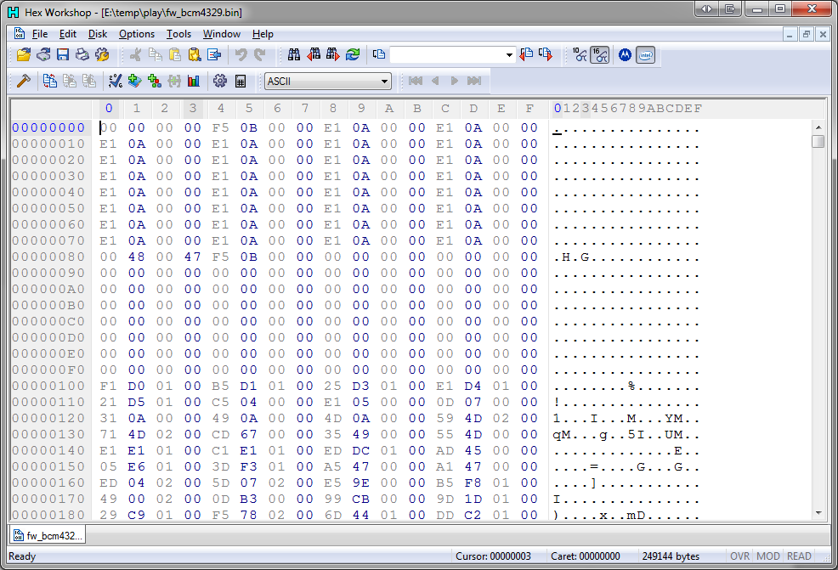
Notes:
We’ve looked at that file in hex editor (CLICK, CLICK), and we guessed that it’s an ARM code in thumb mode. What else can it be? ☺
But actually (CLICK), we shouldn’t have even guessed it’s ARM – it’s written in the datasheet of BCM4330 (CLICK)…

Slide 19
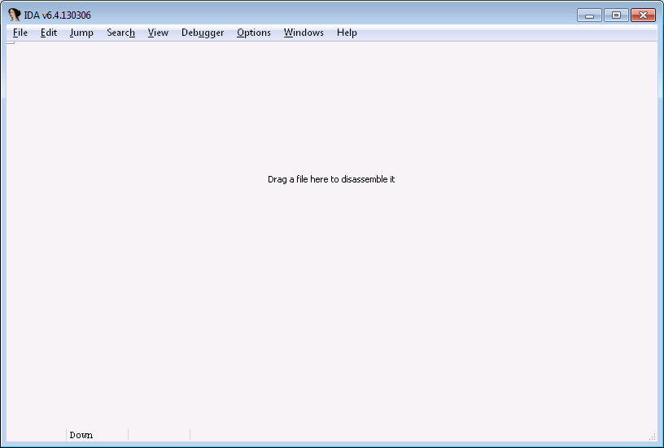
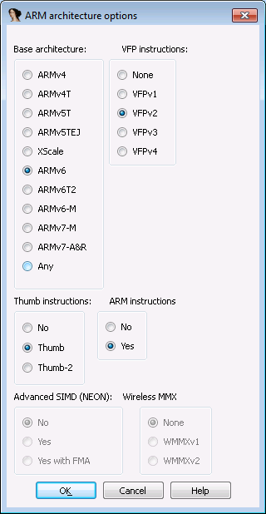
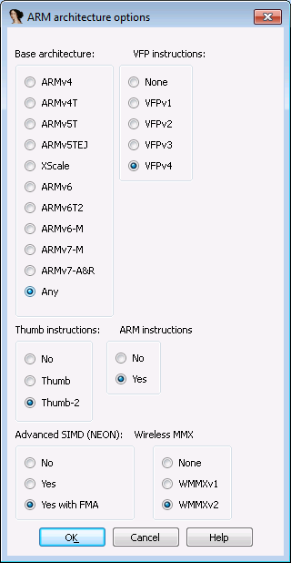
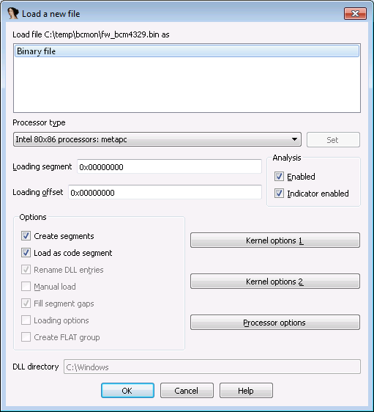
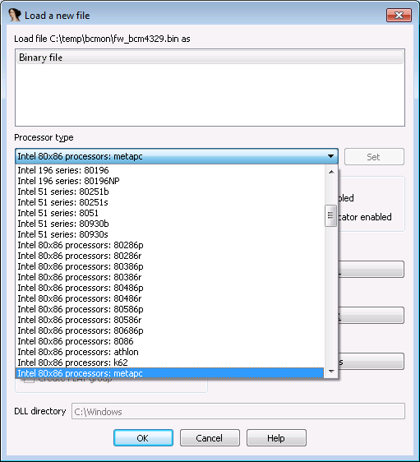
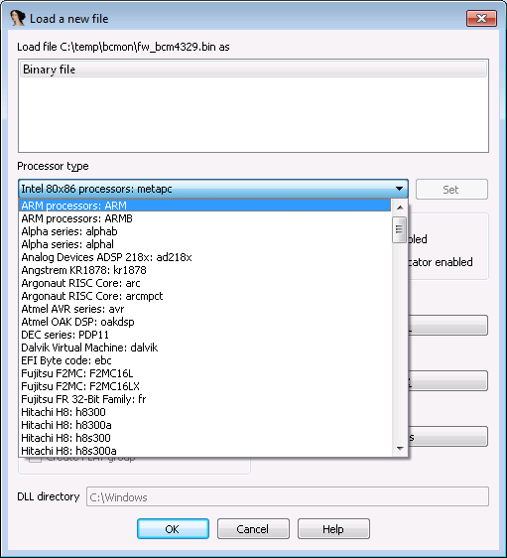
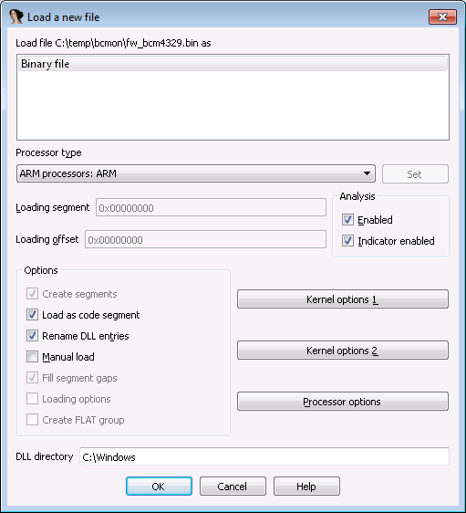
Notes:
So… we loaded the file to IDA (CLICK), chose the correct processor

Slide 20
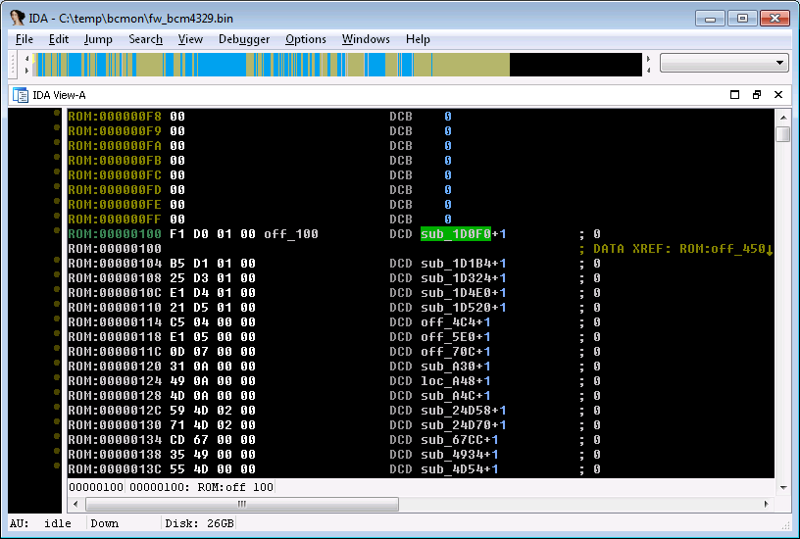
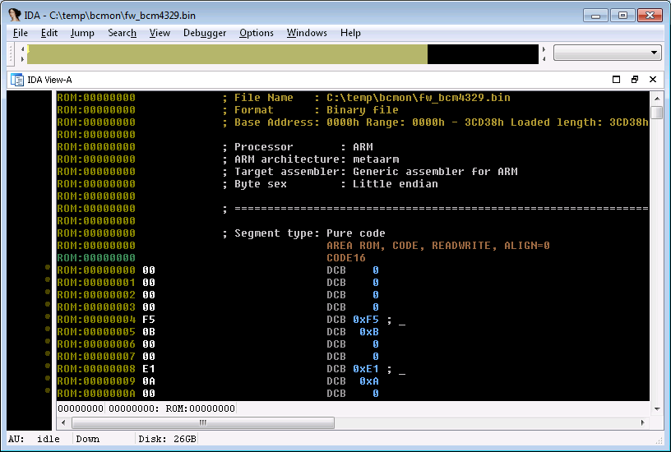
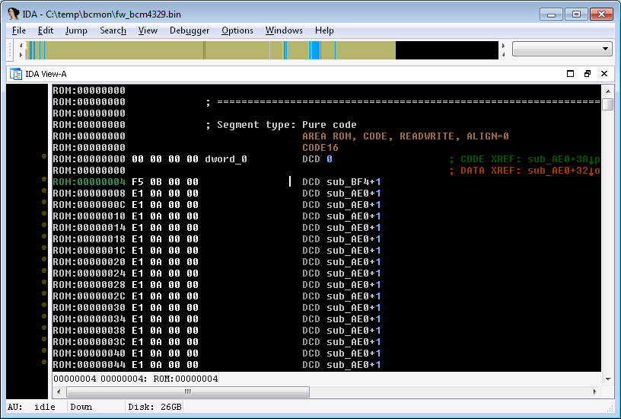
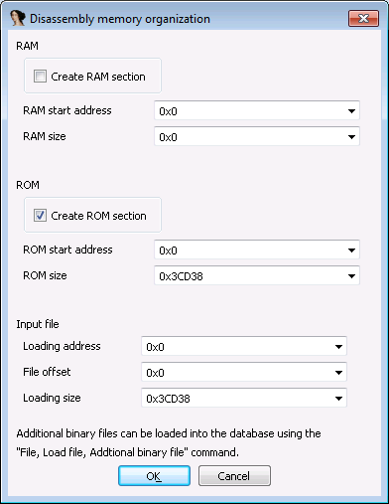
Notes:
Loaded it to address zero,
And we see small 32 bit numbers at the beginning of the FW… it’s probably the Interrupt Vector Table, isn’t it (CLICK)
Yep…
And we continue exploring it (CLICK) and discover some other address table at address 100 (hex)

Slide 21
tasks
Easy solutions
Implement monitor mode ourselves
Extract Firmware
RE firmware
Patch firmware - add monitor mode
Is it possible?
Determine Architecture
Notes:
But before we get to reversing the actual chip – lets see if we can patch it at all, if there isn’t any verification or authentication of the firmware.

Slide 22
# dmesg
.
.
.
Firmware version = wl0: Dec 20 2010 19:21:39 version 4.218.248.18
.
.
.
Notes:
** SWITCH POINT **
Well, as Yuval said we wanted to make sure we can even patch the firmware we’ve found on my phone.
Remember all those debug prints on the dmesg log?
Well, one of them contained the firmware version string, which we easily identified on our firmware code.

Slide 23
Firmware version = wl0: Dec 20 2010 19:21:39 version 4.218.248.18
000284B0 00 34 2E 32 31 38 2E 32 .4.218.2
000284B8 34 38 2E 31 38 00 77 6C 48.18.wl
000284B0 00 62 63 6D 6F 6E 00 32 .bcmon.2
000284B8 34 38 2E 31 38 00 77 6C 48.18.wl
Firmware version = wl0: Dec 20 2010 19:21:39 version bcmon
Notes:
So we patched it! Replaced the version string from what it was to “bcmon”, reloaded the fw and luckly for us it worked.
And after verifying that there is no verification on the fw, we got back to reversing it…

Slide 24
~67% of the functions are missing
Notes:
Lets talk a little about the fw:
We’ve got around 250k of arm code.
We’ve have an interrupt table at 0.
But more interesting is a function table at the beginning of the firmware (at address 0x100).
As you can see one the screen there are a lot of red rows,
And the red rows in this table is a signal from ida that we have some code missing.
Sadly for us, we had many function pointers, pointing to addresses outside of our firmware file.
We didn’t like the fact that we have a missing region so…

Slide 25
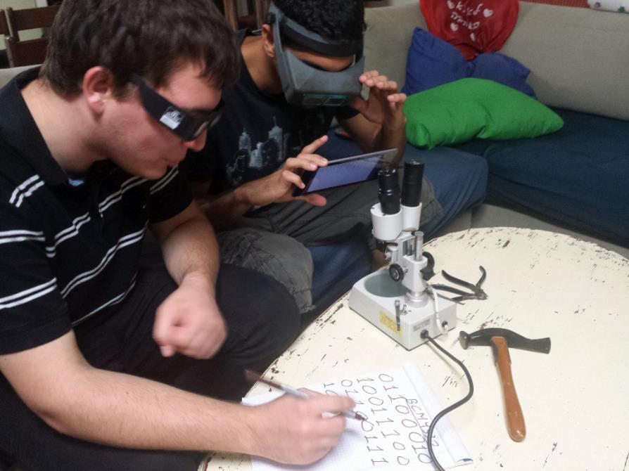
Notes:
So we did something about it
We managed to extract some of the missing code that way, but we wanted to do even better…

Slide 26
# dmesg
.
.
.
dhdsdio_download_code_file: download firmware /system/vendor/firmware/fw_bcm4329.bin
dhdsdio_membytes: write 2048 bytes at offset 0x00000000
dhdsdio_membytes: write 2048 bytes at offset 0x00000800
dhdsdio_membytes: write 2048 bytes at offset 0x00001000
dhdsdio_membytes: write 2048 bytes at offset 0x00001800
dhdsdio_membytes: write 2048 bytes at offset 0x00002000
dhdsdio_membytes: write 2048 bytes at offset 0x00002800
dhdsdio_membytes: write 2048 bytes at offset 0x00003000
.
.
.
dhdsdio_membytes(dhd_bus_t *bus,
bool write,
u32 address,
u8 *data,
uint size)
Notes:
So we got back to the dmesg log, and looked those debug prints that are printed during the uploading of the fw to the chip.
We have looked at the function “dhdsdio_membytes’’, that does that, and noticed that one of the parameters
controls whether this function writes to the chip memory or reads it!

Slide 27
static int
dhdsdio_download_code_file(struct dhd_bus *bus, char *fw_path){
.
.
.
/* Download image */
while ((len = dhd_os_get_image_block((char*)memptr, MEMBLOCK, image))) {
bcmerror = dhdsdio_membytes(bus, TRUE, offset, memptr, len);
if (bcmerror) {...}
offset += MEMBLOCK;
}
.
.
.
}
Notes:
Happy with our new discovery,
we patched the function in the driver that is responsible of uploading the firmware to the chip
* remember that the driver on android is open source, so we can patch it

Slide 28
static int
dhdsdio_download_code_file(struct dhd_bus *bus, char *fw_path){
.
.
.
/* Download image */
while ((len = dhd_os_get_image_block((char*)memptr, MEMBLOCK, image))) {
bcmerror = dhdsdio_membytes(bus, TRUE, offset, memptr, len);
if (bcmerror) {...}
offset += MEMBLOCK;
}
pasten_func(bus);
.
.
.
}
Notes:
And added our “pasten_func” after the loading process.
BTW, pasten is the hebrew word for pwnage

Slide 29
int pasten_func (struct dhd_bus *bus)
{
bool write;
uint32 address;
uint8 data[0x100];
uint32 chunk_sz = 0x100;
printf("pasten_func: enter!!!\n");
write = false;
address = 0x1E000000;
while(true)
{
dhdsdio_membytes(bus, write, address, data, chunk_sz);
printf("address = 0x%X\n", address);
hexdump("pasten OUT: ", data, chunk_sz);
address += chunk_sz;
}
printf("pasten_func: return!!!\n");
return 0;
}
Notes:
This is the entire code we wrote to extract the missing region.
Actually our ‘pasten_func’ just reads the mission region in a loop.
We did that by using the same function that broadcom uses to load the firmware into the chip.

Slide 30
dmesg
#
.
.
.
address = 0x1E000000
pasten OUT: 13 b5 01 90 00 91 05 e0 07 4b 01 a9 1b 68 6a 46
pasten OUT: 98 47 38 b9 01 98 00 99 dd 22 0f f0 b1 fc 04 46
pasten OUT: 00 28 f1 d1 20 46 1c bd 5c 03 00 00 2d e9 f0 41
pasten OUT: 43 78 45 1c 04 2b 04 46 0f 46 16 46 07 d9 02 30
pasten OUT: 09 49 04 22 0f f0 a4 fc 08 b9 01 30 0a e0 2b 78
pasten OUT: 3a 68 a1 1c c9 18 33 68 c2 eb 01 02 9b 1a 33 60
pasten OUT: 39 60 00 20 bd e8 f0 81 08 fe 00 1e 10 b5 04 46
pasten OUT: 4f f0 00 0e 10 46 09 e0 1e f8 01 c0 1e f8 00 20
pasten OUT: 94 45 01 d0 34 b9 08 e0 0e f1 01 0e 9e 45 f3 d1
pasten OUT: 00 20 0b e0 62 45 08 d9 08 e0 10 f8 0e 20 11 f8
pasten OUT: 0e 30 9a 42 28 bf 08 46 00 e0 08 46 10 bd c0 46
.
.
.
Notes:
And SUCCESS!!

Slide 31
Notes:
We manage to extract the missing region!

Slide 32
tasks
Easy solutions
Implement monitor mode ourselves
Extract Firmware
RE firmware
Patch firmware - add monitor mode
Is it possible?
Notes:
so we can get back to the monitor mode thing.

Slide 33
RAM
ROM
Function Pointers
memset
RW
RO
Notes:
Now (after extracting the mission region),
we have two code segments:
RAM segment – which we can modify, by changing the fw file.
ROM segment – that is unchangeable (maybe even masked rom).
But what if broadcom finds a bug in their unchangeable ROM segment? How can they fix it?
It turns out that the function table we just showed you allows broadcom the patch their ROM segment.

Slide 34
RAM
ROM
memset_wrapper
Function Pointers
memset
RW
RO
Notes:
Broadcom can fix their code because almost every functions in the rom segment have a special wrapper,
That wrapper checks this special function table and jump to the relevant fix code if necessary.
For example, if Broadcom finds a bug in memset, they can update the pointer and point the wrapper to a new code with the fixed memset.
This was crucial to our project because it allowed us to patch what was otherwise a READ ONLY code.

Slide 35
DEBUG
PRINTS
Notes:
What about debug prints? Everybody love debug prints..
Broadcom code didn’t have a lot of debug prints, but one of them happened to be very useful.

Slide 36
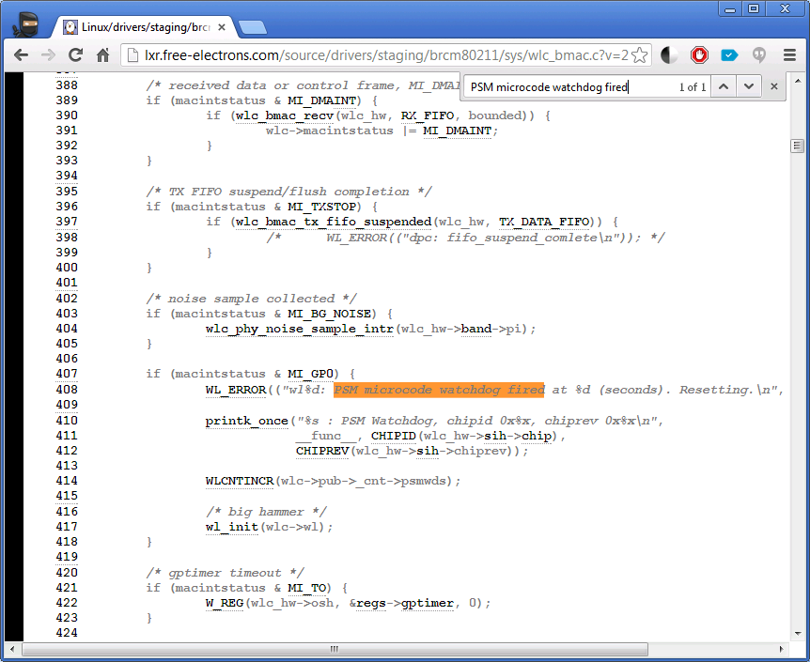
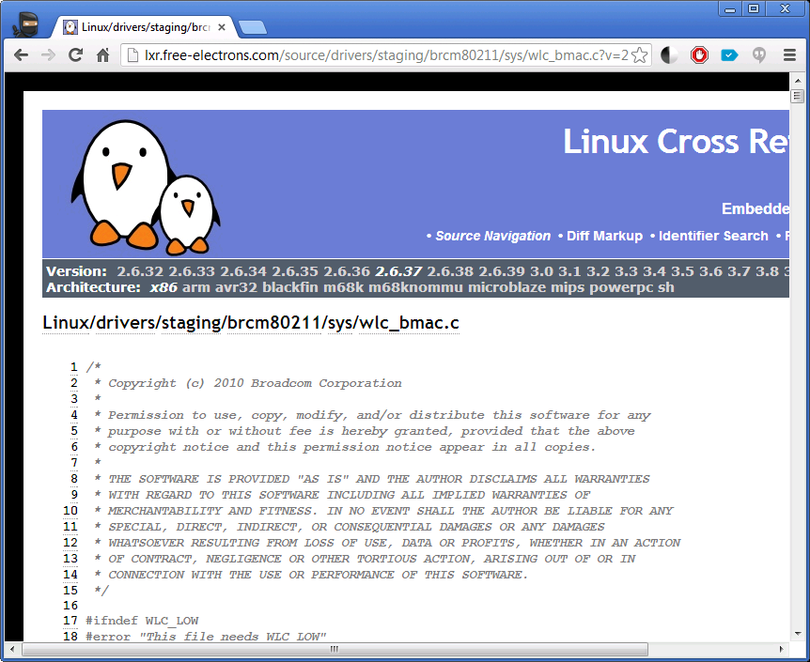
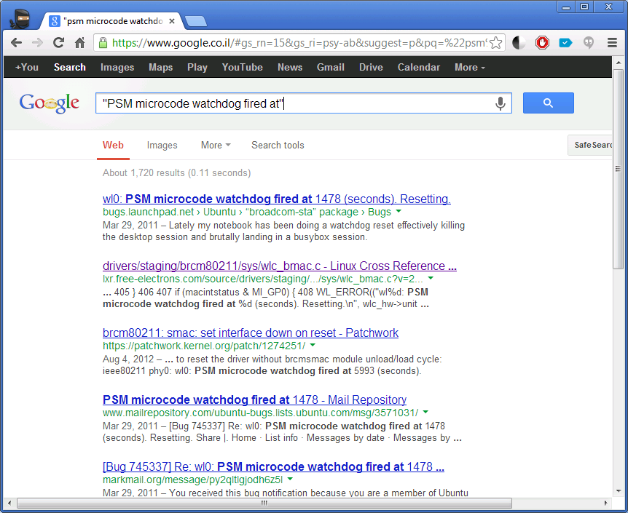
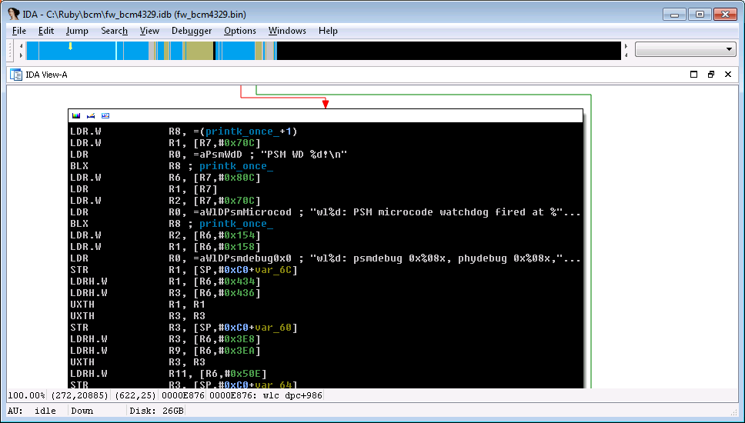
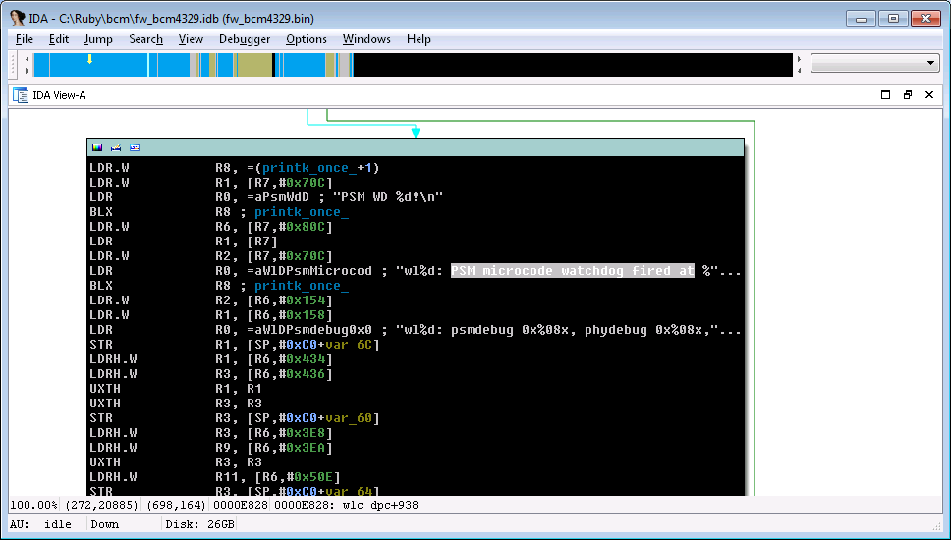
Notes:
We’ve found a “watchdog releated” debug print, we’ve googled it, and found it in a softmac driver from Broadcom.
and if you think about it, it makes sense that Broadcom will share some code across their different products…
This code was very similar to our fw code and it helped us understand the fw more quickly.

Slide 37
Why Ethernet?? WHY???
Notes:
At this point, we don’t know much about the code…and we are trying to find something to hold on to.
What we really want is to see a raw WiFi frame, before any translation…
What you see now on the screen is called an LLC header
And every WiFi data frame out there contains this header, so we looked for this magic stream of bytes…

Slide 38
Notes:
And found some dozen references to it…
Since this “Magic LLC Header” don’t go into the Ethernet packet, it seemed like a nice starting point.
And we started working on them one by one…
So we look at the first reference, we guess which parameter contains the raw wifi frame… But how do we check it?

Slide 39
push {r0-r11, lr}
; pre logic
bl original_function
; post logic
pop {r0-r11, pc}
Notes:
We check it by writing a simple detour, that wraps the original function. Adding our code before the function starts and after it returns… We write this detour in ARM assembly…
Assemble it, and …
Take the output and paste it in our fw.
But that’s not enough, because what we really want is to check if the function handles raw WiFi frames..
And in order the check if the function does that we need to read that “frame” and check if it’s indeed “wifi frame”…
Since we can’t pause the chip…

Slide 40
push {r0-r11, lr}
; pre logic
bl original_function
;
; memcpy(0x46300, sp, 0x100)
;
pop {r0-r11, pc}
int pasten_func (struct dhd_bus *bus)
{
...
printf("pasten_func: enter!!!\n");
dhdsdio_membytes(...);
...
}
Notes:
We want to copy the “frame” to an unused memory location…
Which we can read using the same method we’ve used to extract the mission region.
And this methods involves recompiling the kernel for each patch.
But what if…

Slide 41
push {r0-r11, lr}
; bug <----------------
bl original_function
;
; memcpy(0x46300, sp, 0x100)
;
pop {r0-r11, pc}
int pasten_func (struct dhd_bus *bus)
{
...
printf("pasten_func: enter!!!\n");
dhdsdio_membytes(...);
...
}
PANIC
Notes:
we have a bug somewhere in this long process?
Well in that case we get a kernel panic…

Slide 42
tasks
Easy solutions
Implement monitor mode ourselves
Extract Firmware
RE firmware
Patch firmware - add monitor mode
Is it possible?
Save time
Research infrastructure
Notes:
So to avoid wasting our time, we wanted to develop …
two research tools:
The first was for binary patching
And the second was to avoid recompiling the kernel for each patch.

Slide 43
Developing a patch
Develop in C
Easily add illegal opcodes
Detours
Assembly patches
Notes:
The first tool we wrote was the “generic_patcher.py”, it’s a small python script that wraps' all the binary patching tasks, and allows fast and easy development of patches in C instead of assembly.

Slide 44
generic_patcher.py
detour1 = CPatch(code_address, “detour.c”, max_size=0x100)
patch_firmware("fw_bcm4329.bin", "patched.bin", [detour1])
Notes:
here is an example of how we add a patch to the fw, using our “generic_patcher.py” script:
We assign a destenation address for the output code
We point it to our source c_file
And we state how much size the patch is allowed to use
And that’s all we need to do…

Slide 45
Additional Patch Types
Assembly
ArmPatch(0x00006E30, ["nop", "nop"])
Detour relative jumps
BLPatch(bl_ptr, new_dst)
PTR replacement
ReplacePatch(old_data, new_data)
Trap
TrapPatch(offset)
ArmPatch(0x00006E30, ["nop", "nop"])
BLPatch(bl_ptr, new_dst)
ReplacePatch(old_data, new_data)
TrapPatch(offset)
Notes:
Among other “Types” of patches we can write with our “Generic patcher.py”:
We have a patch type for writing assembly
And patch type for fixing function calls
One for replacing function pointers
And last but not least, we can insert an illegal opcode which results in lots of debugging information printed on the dmesg log.

Slide 46
generic_patcher.py
push {r0-r11, lr}
; pre logic
bl original_function
;
; memcpy(0x46300, sp, 0x100)
;
pop {r0-r11, pc}
int pasten_func (struct dhd_bus *bus)
{
...
printf("pasten_func: enter!!!\n");
dhdsdio_membytes(...);
...
}
PANIC
Notes:
That’s was the first tool we wrote which helped us with the binary patching tasks
But we still had to recompile the kernel for each patch…
And we wanted to avoid kernel modification as much as we can…

Slide 47
Usermode Interface
Read/write chip memory
Change kernel debug level
Notes:
so we’ve exposed some useful functions from the kernel to the usermode,
And wrote the second tool that allowed us to read and write the chip memory from user mode.

Slide 48
Usermode Interface
read_mem: address(0x1E000000), count(0x00000100):
0000 13 b5 01 90 00 91 05 e0 07 4b 01 a9 1b 68 6a 46 .........K...hjF
0010 98 47 38 b9 01 98 00 99 dd 22 0f f0 b1 fc 04 46 .G8......".....F
0020 00 28 f1 d1 20 46 1c bd 5c 03 00 00 2d e9 f0 41 .(.. F..\...-..A
0030 43 78 45 1c 04 2b 04 46 0f 46 16 46 07 d9 02 30 CxE..+.F.F.F...0
0040 09 49 04 22 0f f0 a4 fc 08 b9 01 30 0a e0 2b 78 .I.".......0..+x
0050 3a 68 a1 1c c9 18 33 68 c2 eb 01 02 9b 1a 33 60 :h....3h......3`
0060 39 60 00 20 bd e8 f0 81 08 fe 00 1e 10 b5 04 46 9`. ...........F
0070 4f f0 00 0e 10 46 09 e0 1e f8 01 c0 1e f8 00 20 O....F.........
0080 94 45 01 d0 34 b9 08 e0 0e f1 01 0e 9e 45 f3 d1 .E..4........E..
0090 00 20 0b e0 62 45 08 d9 08 e0 10 f8 0e 20 11 f8 . ..bE....... ..
00a0 0e 30 9a 42 28 bf 08 46 00 e0 08 46 10 bd c0 46 .0.B(..F...F...F
00b0 2d e9 70 47 bb b0 0d f1 df 04 06 46 88 46 91 46 -.pG.......F.F.F
00c0 19 49 09 22 20 46 9a 46 0f f0 72 fc 20 46 0f f0 .I." F.F..r. F..
00d0 b5 f9 0d f1 0f 05 02 46 21 46 28 46 0f f0 68 fc .......F!F(F..h.
00e0 20 46 0f f0 ab f9 31 46 04 46 06 22 28 18 0f f0 F....1F.F."(...
00f0 5f fc a0 1d 41 46 06 22 28 18 0f f0 59 fc 0d f1 _...AF."(...Y...
Notes:
This is an example…
For the chip memory that we’ve dumped using this tool

Slide 49
generic_patcher.py
Usermode interface
int pasten_func (struct dhd_bus *bus)
{
...
printf("pasten_func: enter!!!\n");
dhdsdio_membytes(...);
...
}
PANIC
Notes:
So no more patching the kernel each time

Slide 50
tasks
Easy solutions
Implement monitor mode ourselves
Extract Firmware
RE firmware
Patch firmware - add monitor mode
Is it possible?
Save time
Research infrastructure
Find a raw WiFi Packet
Notes:
And back to our tasks: we have new research tools, it’s time to get back to reversing the firmware…
<CLICK>
And to be more specific , we want to find raw WiFi packets

Slide 51
Notes:
Back to those LLC HEADER references…
We started working on them one by one, writing simple detours to find out which one of them are easily reachable.
And soon we’ve found one reference that got a real raw WiFi frame…

Slide 52
Our first raw 802.11 packet!
wlc_bmac_recv
...
ROM:0000D35C 04 F1+ ADD.W R0, R4, #0x10
ROM:0000D360 // got here with a probe request packet
ROM:0000D360 F4 F7+ BL my_mac_compare_
ROM:0000D364 18 B9 CBNZ R0, loc_D36E
ROM:0000D366 23 7C LDRB R3, [R4,#0x10]
ROM:0000D368 13 F0+ TST.W R3, #1
Probe request
0003d510: 00 00 14 04 cc 00 f8 4d 40 00 00 00 ff ff ff ff
0003d520: ff ff 00 21 91 98 7d c3 ff ff ff ff ff ff b0 6b
0003d530: 00 05 4b 61 6c 69 72 01 08 82 84 8b 96 12 24 48
0003d540: 6c 32 04 0c 18 30 60 05 b8 34 27 00 00 00 00 00
Notes:
And this is the first raw WiFi frame we’ve extracted from my Nexus One.
We have extracted it using a simple detour that copied the frame to the end of the stack,
And read from the chip memory using our usermode interface tool.
This was a very exciting moment in our project

Slide 53
tasks
Easy solutions
Implement monitor mode ourselves
Extract Firmware
RE firmware
Patch firmware - add monitor mode
Is it possible?
Save time
Research infrastructure
Find a raw WiFi Packet
Find a route home
Notes:
Anyway…after relaxing a little bit…
And since our method of extracting raw frames is slow and impractical…
We realized that we need to find out how the chip “normally” sends packets to the OS.

Slide 54
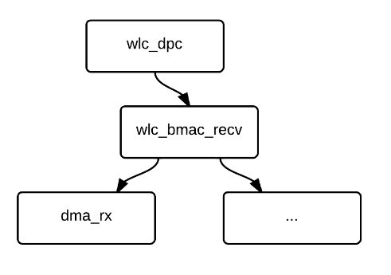
Notes:
We don’t have time to get into all the nifty details but, long story short:
We’ve found that the function wlc_bmac_recv handles all the incoming packets,
All those raw WiFi packets are arriving from a function called dma_rx.
Wlc_bmac_Recv then calls some functions that handles all those frames, translates them into ethernet
and eventually sends the frames to the OS.

Slide 55
Notes:
After identifying the both the function that recv the raw frame and the function that sends the translated frame
we could just bypass all that wifi to ethernet translation by connecting those two ☺

Slide 56
Raw packet sniffing
Notes:
Great success!@!, but…
We're only seeing broadcasts

Slide 57
Capture the flag
Notes:
We guessed that we “just” need to find the right flag to put the device in “promisc”

Slide 58
/*== maccontrol register ==*/
#define MCTL_GMODE (1U << 31)
#define MCTL_DISCARD_PMQ (1 << 30)
#define MCTL_WAKE (1 << 26)
#define MCTL_HPS (1 << 25)
#define MCTL_PROMISC (1 << 24)
#define MCTL_KEEPBADFCS (1 << 23)
#define MCTL_KEEPCONTROL (1 << 22)
#define MCTL_PHYLOCK (1 << 21)
#define MCTL_BCNS_PROMISC (1 << 20)
#define MCTL_LOCK_RADIO (1 << 19)
#define MCTL_AP (1 << 18)
#define MCTL_INFRA (1 << 17)
#define MCTL_BIGEND (1 << 16)
#define MCTL_GPOUT_SEL_MASK (3 << 14)
#define MCTL_GPOUT_SEL_SHIFT 14
#define MCTL_EN_PSMDBG (1 << 13)
#define MCTL_IHR_EN (1 << 10)
#define MCTL_SHM_UPPER (1 << 9)
#define MCTL_SHM_EN (1 << 8)
#define MCTL_PSM_JMP_0 (1 << 2)
#define MCTL_PSM_RUN (1 << 1)
#define MCTL_EN_MAC (1 << 0)
void brcms_c_mac_promisc(struct brcms_c_info *wlc, uint filter_flags)
{
u32 promisc_bits = 0;
wlc->filter_flags = filter_flags;
if (filter_flags & (FIF_PROMISC_IN_BSS | FIF_OTHER_BSS))
promisc_bits |= MCTL_PROMISC;
if (filter_flags & FIF_BCN_PRBRESP_PROMISC)
promisc_bits |= MCTL_BCNS_PROMISC;
if (filter_flags & FIF_FCSFAIL)
promisc_bits |= MCTL_KEEPBADFCS;
if (filter_flags & (FIF_CONTROL | FIF_PSPOLL))
promisc_bits |= MCTL_KEEPCONTROL;
brcms_b_mctrl(wlc->hw,
MCTL_PROMISC | MCTL_BCNS_PROMISC |
MCTL_KEEPCONTROL | MCTL_KEEPBADFCS,
promisc_bits);
}
Notes:
Luckily for us we found some interesting flags like MCTL_PROMISC on other broadcom sources.
we also found a function that plays with them.

Slide 59
Result
Notes:
after adding the call to this function we’ve achieved monitor mode!
this is the real deal, working with native unpatched tools.
Btw: this is a picture of airodump running on my nexus one ☺

Slide 60
tasks
Implement monitor mode ourselves
Save time
Research infrastructure
Notes:
So we’ve implemented monitor mode but it’s not enough

Slide 61
tasks
Implement monitor mode ourselves
Packet injection support
Save time
Research infrastructure
Notes:
We now want to add injection support…
** SWITCH POINT **
Sniffing raw packets is nice, but the slow frustrating WEP-cracking days are a thing of the past. Nowadays, We use packet injection to implement smarter & faster attacks.
And so, with our new packet sniffing ability at hand, we went on to try and implement packet injection…
But first, our infrastructure needed to be upgraded.

Slide 62
Tracing
Function 1 Called!
Function 2 Called!
DNS Packet Sent!
Ping Packet Sent!
Notes:
We thought – What is the BEST way to find out how to inject packets?
The best way we could think of was finding functions that are called whenever we send a packet.
To find these functions, we wanted a tracing system that logs events on a timeline. We wanted to log both packets and function calls.
You know what? Let’s save the explanation for later on and skip to the demo first ☺

Slide 63
Demo !!!
Notes:
What Ruby is loading right now is a patched firmware that hooks one of our candidates.
Then, We’ll send ping packets from the phone, and see the log that it generates. This should allow us to find out if we’re correct.
-------------------
Now Ruby will show us an example of using that logging system to test one of our assumptions.
This firmware logs a call to a function that we think should receive outgoing packets – pings for example.

Slide 64
Tracing
Stack trace
Real time packet buffers (sk_buff)
Function arguments
Return values
Notes:
A summary of the abilities this infrastructure gave us:
Stack trace of the current point
Raw packets from the chip (sk_buffs)
Function arguments that interest us
Return values (if we wish)
Whatever we wish!

Slide 65
Upgrading our tracing system
Generic Patcher
my_log(skb, arg1,arg2,arg3,'dma_','tx!!','!!!!')
CHIP
Packets+Logs
Update.sh
Notes:
Ok, as usual, we’d rather have a script that does as much as we can, because we make mistakes, our script doesn’t ☺
We run update.sh, it, in turn, compiles our current patch. Somewhere in that patch we add a call to our new logging function – my_log
Then, the script uploads and updates the chip’s firmware, and that’s it, we’re up and running.
Now, we start tcpdump, and start receiving packets AND logs interleaved. This sniffing log is then reviewed using wireshark with our LUA dissector

Slide 66
tasks
Implement monitor mode ourselves
Packet injection support
Save time
Research infrastructure
Notes:
Using this firmware we quickly found the right flow to inject packets. Power through infrastructure.
Great! Our monitor mode is now complete! We can both sniff and send raw packets from our device.
With these two, we could run every WiFi pwnage tool available right from Ruby’s phone…
The only problem was…

Slide 67
Nexus One
BCM4329
SGS II
BCM4330B1
Nexus 7
BCM4330B2
SGS III
BCM4334
SGS IV
BCM4335
Notes:
They could only run from Ruby’s phone…
I didn’t do this project so that Ruby will be able to pwn WiFi… I wanna do it myself…
I have SGS II, which has a different chipset – the BCM4330. so we went on to research it as well.
At this point we went on to research the SGS II, which had a different chipset – the BCM4330
emphasize the SGS II

Slide 68
RAM
ROM
Function Pointers
memset
Notes:
We figured it wouldn’t be too hard to do the same tricks again…
The first trick – reading the missing region.
We tried reading the missing region using the same method as before, and… failure.
The reading failed. And when we investigated further, we found out that reading from the RAM section succeeded, but from the ROM failed.
We thought there must be some limitation of the reading function,
And since we could see the chip itself uses this memory region, because we could see function pointers pointing to it.
OK, that’s not too hard… we know this chip, we know its code already, we’ll just have to copy the ROM section elsewhere.
But where?... We dumped the entire RAM and began searching for a suitable place… (pause)

Slide 69
RAM
ROM
CODE CODE CODE CODE CODE CODE CODE CODE ...
Function Pointers
memset
Copy Stub
?????????????????????????????????????????...

Slide 70
Notes:
Very soon afterwards – we found one.
This is taken from our dump, and, for those having a hard time to see, written KATS KATS KATS all over the place. Which, in little endian, means – STAK STAK STAK.
This is the top of the stack, which remained unused. We decided to give it a better use.
So we found the function that inits the stack, and wrote our own patch over there.
We dumped

Slide 71
tasks
Implement monitor mode ourselves
Packet injection support
Save time
Research infrastructure
Support other chipsets

Slide 72
Current Solution
Wifi Chip
Kernel module
airodump
Notes:
Now we have a working solution. Our solution involves:
- patching the wifi chipset firmware
- patching the kernel module
But it leaves the usermode completely unpatched – which is a really cool thing!
you can just compile your own, or even download an ARM-precompiled binary of airodump and use it!

Slide 73
Compiling the kernel takes time...
Notes:
But compiling an android kernel takes a long time (and it’s a painful process)

Slide 74
We support 3 chips
Notes:
And we already support more than one chip…

Slide 75
~100 android devices
Notes:
And each chip is embedded in many devices

Slide 76
100 devices # of kernels
$∞$ time
X
Notes:
And today each device has a lot of possible kernels
We sum up with the conclusion that if we want a portable easy-to-use solution, we are going to compile kernels until the day we’ll die.

Slide 77
Staying in userland
This is a problem!
Wifi Chip
Kernel module
airodump
We also like our tools untouched
Notes:
So we decided we need another solution, which is more easy to support:
We had the following requirements:
We cant avoid patching the chipset firmware file. and if we already have to patch it – it doesn matter if we change 1 instruction or add 30 functions…
In addition – we believe that for each chip – there are only a few versions of broadcom firmwares out there, so it’s kinda easy to maintain…
We don’t want ANY kernel patch
We REALLY prefer to leave the tools using monitor mode untouched.
we don’t want any of the tools to be recompiled in a special way – we wanted to take aircrack, compile it for android, and let it do it’s work.
So we thought that the Kernel is seeing the chip as an Ethernet device… so lets play by the rules - we will communicate with the chip using Ethernet from usermode, and over that Ethernet, we’ll do whatever we want…
Lets say the chip just got a wifi packet, now it will take it, encapsulate it in an Ethernet packet and send it to the linux.
This way – we don’t have to touch the kernel! Cross-kernel solution!
But we still need to take care of the thirs requirement – we don’t want to change aircrack…
We don’t want it to see the interface as an Ethernet device, and we want to decapsulate the wifi packet and feed it to aircrack like it expects…
So we thought of 3 options (BTW, any other option will be thankfully accepted ☺ ):
Intercept syscalls using ptrace, but we tried it and it had many problems
Recompile our own “patched” libc, but we already had our aircrack tools compiled….. And we are lazy…
Use LD_PRELOAD…

Slide 78
LD_PRELOAD
Environment variable
Shared object
Loaded first
Ideal for hooking
# LD_PRELOAD=`pwd`/libmytest.so ping 8.8.8.8
HELP!!! I’m trapped inside a foreign binary!!
PING 8.8.8.8 (8.8.8.8) 56(84) bytes of data.
64 bytes from 8.8.8.8: icmp_seq=1 ttl=43 time=75.2 ms
64 bytes from 8.8.8.8: icmp_seq=2 ttl=43 time=75.5 ms
.
.
.
Notes:
LD_PRELOAD is a feature of linux run-time linker. It basically allows you to take a shared library and forcibly load it as part of a new process.
So how we can use it? Let’s imagine that we run airodump with LD_PRELOAD…
When linux will resolve airodump imports – it will use our “library” functions instead of libc’s implementation. So we can override socket(), ioctl(), etc…
Explain LD_PRELOAD loads a shared object before any other .so is loaded, and gets priority in resolving any imported symbol.
DON’T EXPLAIN THE EXAMPLE – It’s there to calm the curiosity of whoever is asking himself how to use it…
Splendid!

Slide 79
int ioctl(int fd, int request, void *data) { ... switch (request) { case SIOCGIFHWADDR: debug_print("Handling HW Addr\n"); struct ifreq* p_ifr; p_ifr = (struct ifreq*)data; p_ifr->ifr_hwaddr.sa_family = ARPHRD_IEEE80211_RADIOTAP; goto done; case SIOCGIWMODE: struct iwreq* p_wrq; p_wrq = (struct iwreq*)data; p_wrq->u.mode = IW_MODE_MONITOR; goto done; } ... }
Notes:
And this is exactly what we did – we overridded libc’s ioctl() function.
As you can see, when the utility will try to find out the network interface’s Hardware Address, we are going to return “It’s a 802.11 Radiotap device!”
And when it will try to check it’s mode – we are going to return “Hey! It’s in monitor mode!”

Slide 80
Staying in userland
LD_PRELOAD
Wifi Chip
Kernel module
airodump
Notes:
Great! Now we have a device-portable solution!
As long as we have the firmware patched – we don’t care if you use stock ROM, cyanogen or anything else – we just need to run as root and we can use aircrack!

Slide 81
tasks
Implement monitor mode ourselves
Packet injection support
Save time
Research infrastructure
Support other chipsets
Idiot proof
Notes:
So it works as long as you have the right chip, and as long as you are root on your device.
We should make it completely “Idiot proof” - you really don’t have to understand anything about wifi to use it.

Slide 82
Demo !!!
Notes:
“It’s that simple, even my grandmother can use it”
Show a demo of the apk in action, running airodump and besside

Slide 83
Nexus One
BCM4329
SGS II
BCM4330B1
Nexus 7
BCM4330B2
SGS III
BCM4334
SGS IV
BCM4335
Notes:
Yeah…. But… This only worked on Ruby’s device…
At this point we went on to research the SGS II, which had a different chipset – the BCM4330
emphasize the SGS II

Slide 84
Lessons Learned
Research Infrastructure
BFS vs. DFS
Google Decompiler
Notes:
While working on that project we learned some things:
- We spent many hours trying doing seziphic work until we decided to write an infrastructure to do the seziphic work for us.
It’s almost never “just this place in the code” and it will almost never “just take few minutes”.
When we started using our infrastructures we actually discovered things we would’nt have discovered otherwise
- When we worked on the RE, we tried to

Slide 85
Related work
monmob - Core Security
Andrés Blanco and Matías Eissler
Monitor Mode on iPhone (also Broadcom chips)
Notes:
patch fw only, requires modifications to the tools

Slide 86
Something Completely Different

Slide 87
Phone
APP
OS
Wifi Chip
Notes:
Since we’re already changing the firmware…

Slide 88
Demo !!!
Notes:
Here you see us trying to surf to black hat and… (Recon loads :)

Slide 89
Where can I get it?
generic_patcher.py
https://github.com/shoote/generic_patcher
Android App (currently for bcm4329/30)
https://bcmon.googlecode.com/files/bcmon.apk
More updates:
bcmon.blogspot.com
contact.bcmon@gmail.com
Notes:
Go to our blog: http://bcmon.blogspot.com

Slide 90
Questions

